Slide 1




pyCGM2
Btk
OpenMA
Scientifical python packages
Core : Python 2.7

Slide 2
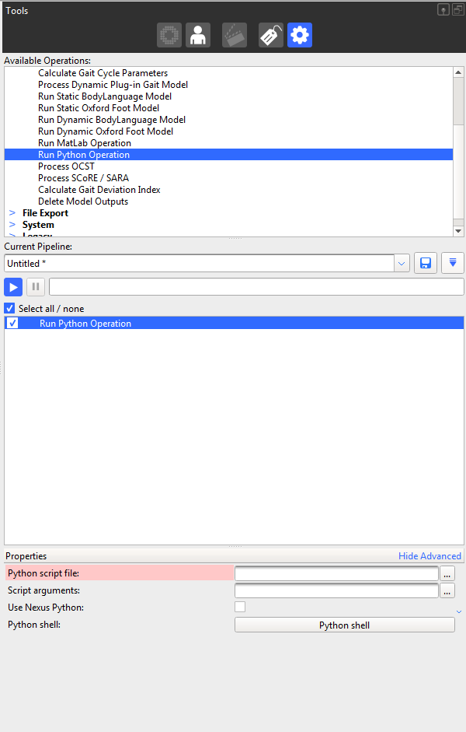
1. Double click on « Run Python Operation »
Add an operation
You can rename by a single click on
2. Add python file from pyCGM2/Apps
3. Add input arguments
Leave unticked this checkBox,

